Slide 1

FALL 2023
MIS 381N
Information management
Lecture 2
August 23rd 2023
Prashant D. Joshi
UT McCombs School of Business (MSBA), The University of Texas at Austin

Slide 2

Objectives
DATA MANAGEMENT STRATEGY
Data Management components
Breakout teams
Team report outs
Data management technology overview
Questions and discussion

Slide 3
What questions may I answer before we begin …
All questions are good questions

Slide 4
Data Management Context

Slide 5
What does Data Management mean to you?
Student responses:

Slide 6
Illustrative Definitions
Gartner—Data Management is the set of practices, architectural techniques, and tools for achieving consistent access to and delivery of data across the spectrum of data subject areas and data structure types in the enterprise, to meet the data consumption requirements of all applications and business processes.
DalleMule & Davenport—A company’s data architecture describes how data is collected, stored, transformed, distributed, and consumed. It includes the rules governing structured formats, such as databases and file systems, and the systems for connecting data with the business processes that consume it. Information architecture governs the processes and rules that convert data into useful information.

Slide 7
Components of Data Management
Business Purpose of Data
Characteristics of Data under Management
Data Management Operating Model
Data Management Technology Architecture

Slide 8
Components of Data Management
Business Purpose of Data
Multiple spectrums to characterize business purpose of data:
defense ←→ offense
internal ←→ external
”run the business” ←→ “grow the business”
…
Is your product/service based on data?
What is the role of data in your digitization roadmap?
Characteristics of Data under Management
Data Management Operating Model
Data Management Technology Architecture

Slide 9
Components of Data Management
Business Purpose of Data
Internal – created through the execution of business processes
External – acquired as supplemental or a necessity for the business
Nature of transactional, streaming, reference, analytical and metadata
Volume?
Velocity?
Variety?
Regulation – requirements for privacy, access, and retention
Characteristics of Data under Management
Data Management Operating Model
Data Management Technology Architecture

Slide 10
Components of Data Management
Four components of the operating model:
Organization (What?)
Governance (Policies, procedures)
Stewardship (Implementation of the policies. Impacts people and technology)
Performance management
Centralized or decentralized?
Sponsorship?
Roles and responsibilities?
Funding framework and philosophy?
Business Purpose of Data
Characteristics of Data under Management
Data Management Operating Model
Data Management Technology Architecture

Slide 11
Components of Data Management
Business Purpose of Data
Dictated by first three components
Centralized and/or distributed?
Structured and/or unstructured?
Relational and/or non-relational
Type of unstructured data: text, images, audio, video, …
Requirements for Reliability, Availability, Serviceability, Usability, Installability (RASUI)
Requirements for security, privacy and retention
Characteristics of Data under Management
Data Management Operating Model
Data Management Technology Architecture

Slide 12
Types of Data Strategy
Defensive
Offensive
Minimize downside risk
Ensure compliance with regulations (rules governing data privacy & integrity of financial reports)
Use analytics to detect & limit fraud
Build systems to prevent theft
Ensure integrity of data—identify, standardize, and govern authoritative data sources (fundamental customer and supplier information or sales data) in a “single source of truth.”
Focus on supporting revenue growth, profitability, and customer satisfaction
Generate customer insights (data analysis and modeling)
Integrate disparate customer and market data to support managerial decision making
https://hbr.org/2017/05/whats-your-data-strategy

Slide 13

Fundamental Dichotomy
Standardize Data
OR
Flexible Data
Points to ponder:
Why have standardized data?
Why have flexible data?

Slide 14
SSOT AND MVOT
The SSOT-MVOTs model requires robust data controls, standards, governance, and technology.
Multiple Versions of Truth
Multiple Versions of Truth
Single Source of Truth (SSOT)
Multiple Versions of Truth
Multiple Versions of Truth
https://hbr.org/2017/05/whats-your-data-strategy

Slide 15
Fundamental Dichotomy Resolution
Standardize Data
AND
Flexible Data

Slide 16
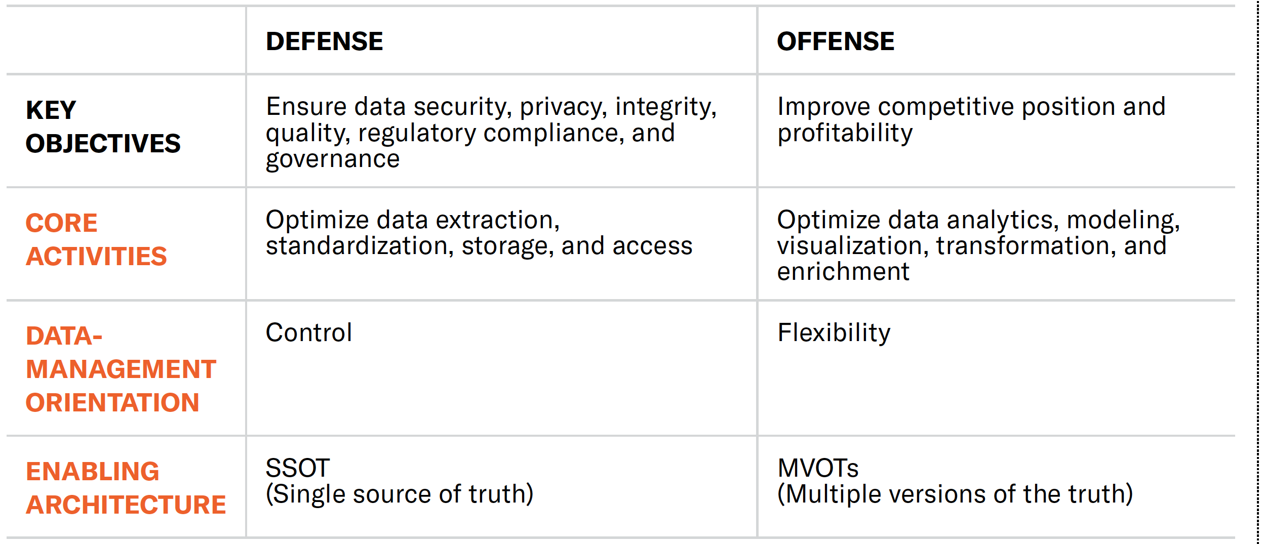
Elements of Data Strategy
https://hbr.org/2017/05/whats-your-data-strategy

Slide 17
Not having an SSOT can lead to chaos
The SSOT is a logical, often virtual and cloud-based repository that contains one authoritative copy of all crucial data, such as customer, supplier, and product details.
It must have robust data provenance and governance controls to ensure that the data can be relied on in defensive and offensive activities, and it must use a common language—not one that is specific to a particular business unit or function.
An SSOT is the source from which multiple versions of the truth are developed.
https://hbr.org/2017/05/whats-your-data-strategy

Slide 18
MVOT – data imbued with relevance and purpose
MVOTs result from the business-specific transformation of data into information—data imbued with “relevance and purpose”
As various groups within units or functions transform, label, and report data, they create distinct, controlled versions of the truth that, when queried, yield consistent, customized responses according to the groups’ predetermined requirements.
https://hbr.org/2017/05/whats-your-data-strategy

Slide 19
Good governance, good data
Data definitions may be ambiguous and mutable
Data rules are vague or inconsistently applied
Feedback loops for improving data transformation are absent
It’s critical is that single sources of the truth remain unique and valid, and that multiple versions of the truth diverge from the original source only in carefully controlled ways—with provenance (knowledge of where the data came from, why was it created).
https://hbr.org/2017/05/whats-your-data-strategy

Slide 20
Striking a balance
To determine a company’s current and desired positions on the offense-defense spectrum, the CDO must bear in mind, among other things:
The company’s overall strategy
Its regulatory environment
The data capabilities of its competitors
The maturity of its data-management practice
The size of its data budget
https://hbr.org/2017/05/whats-your-data-strategy

Slide 21
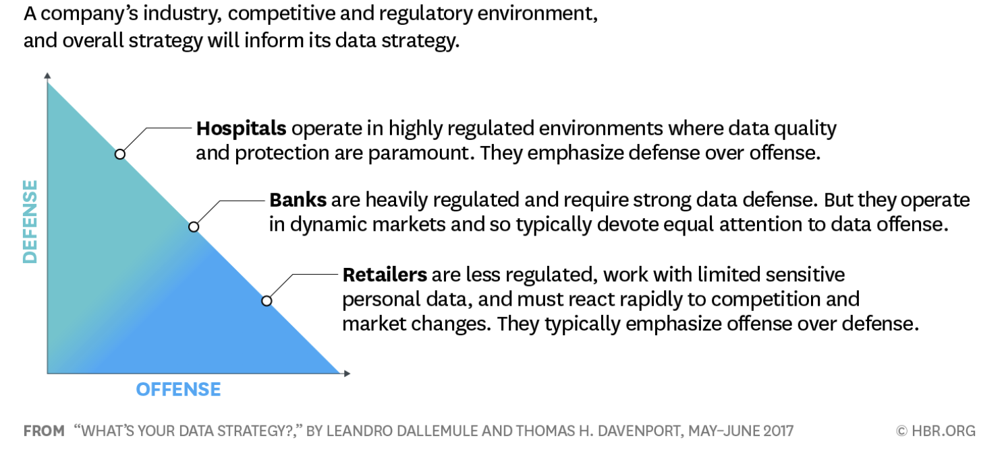
The Data Strategy Spectrum
https://hbr.org/2017/05/whats-your-data-strategy

Slide 22
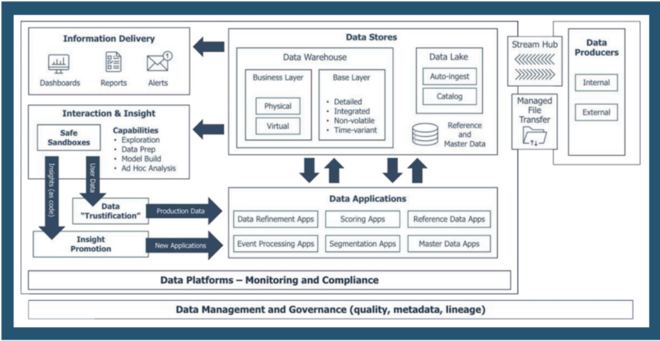
Typical Data Management Technology Ecosystem (Example)
https://www.impactmakers.com/papers/playbook-modern-data-ecosystems/

Slide 23
Terms
pollev.com/prashantjoshi767
Client
Server
Database server
Network
Client/server system,
Local area network (LAN)
Enterprise system
Wide area network (WAN)
Database management system (DBMS)
Back end
Application software
Application programming interface (API)
Data access API
JDBC (Java Database Connectivity)
Front end
SQL (Structured query language)
Query
Query results
Application server
Web server
Business component
Web application
Web service
Web browser
Relational database
Table
Row
Column
Record
Field
Cell
Value
Primary key
Composite primary key
Non-primary key
Index
Foreign key
One-to-many relationship
Many-to-many relationship
Data type
Null value
Default value
SQL Dialect
Data manipulation language (DML)
Data definition language (DDL)
Database administrator (DBA)
Join
PL/SQL (Procedural Language/SQL)
View

Slide 24
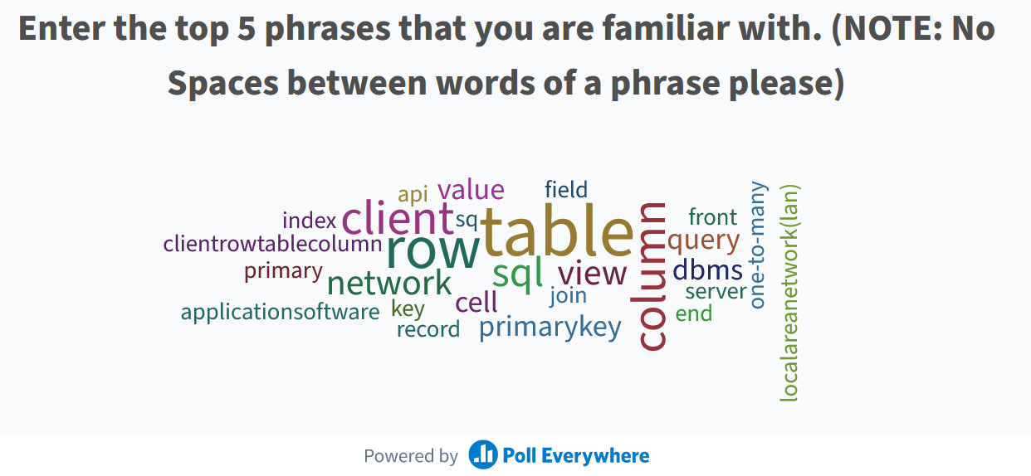
Pollev results

Slide 25
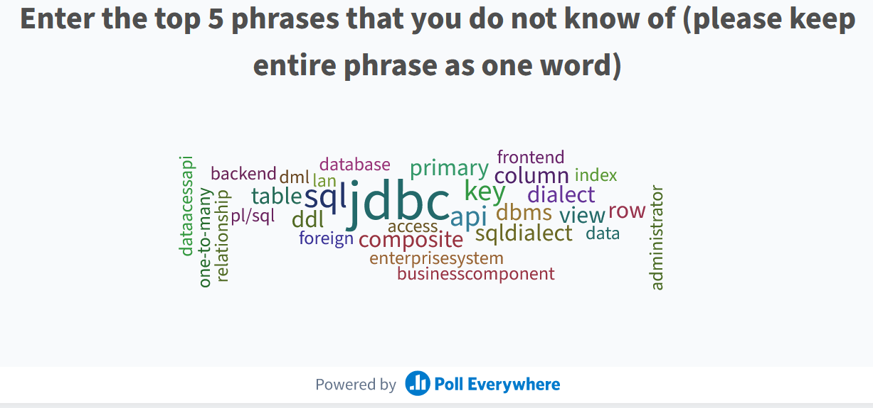

Slide 26

Next class
Review of relational database modeling and relational database management systems
Read articles and review video(s) that will be posted on Canvas
Come prepared to discuss and work in teams

Slide 27
What question may I answer before we end …?
Remember, all questions are good questions!

